Slide 1
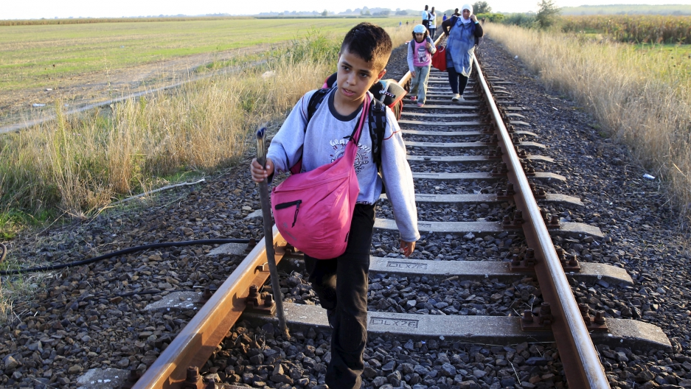
A dignified journey for refugees
Team Seek Refuge
Notes:
I’d like to take you on a journey to

Slide 2
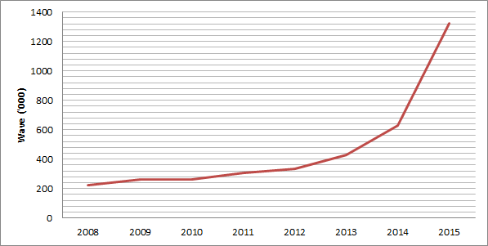
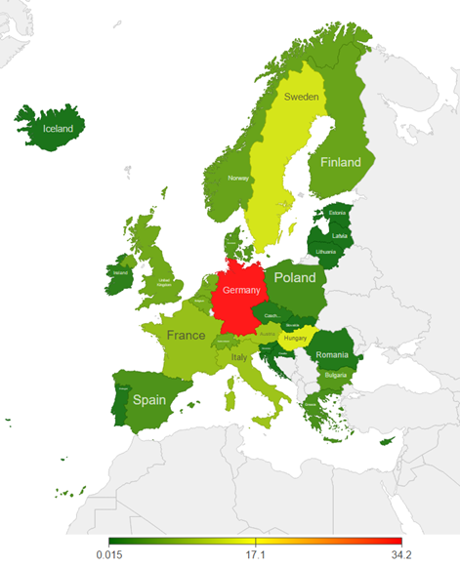
Unprecedented increase in asylum applications in the EU
Notes:
The world is experiencing the largest refugee crisis since the second World War. We expect this number to grow with the rise in conflicts around the world.
Sources: http://www.migrationwatchuk.org/key-topics/asylum; http://www.theguardian.com/news/datablog/2015/aug/20/asylum-seekers-eu-comparison-germany-datablog

Slide 3

Syria
Iraq
European Union
Afghanistan
Somalia
Notes:
Refugees take on flimsy rubber boats and cross the Aegean sea for better lives. In Greece, more than 85% of refugees come from war-torn countries such as Syria, Afghanistan, Iraq and Somalia.
Source: http://alphaomegatranslations.com/alpha-omega-news/how-we-are-helping-with-the-refugee-crisis/

Slide 4

Types of support services provided by INGOs...
Mental health
Education
Health care
Legal support

Slide 5


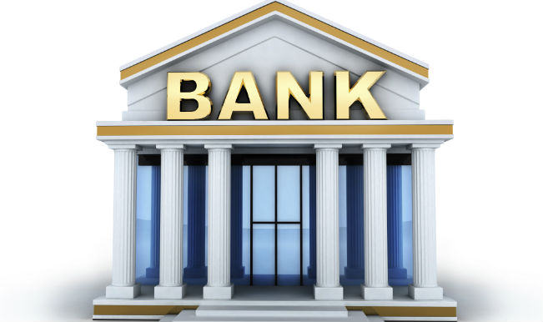
Cash transfer is powerful...
...but transaction costs are high

Slide 6


Slide 7
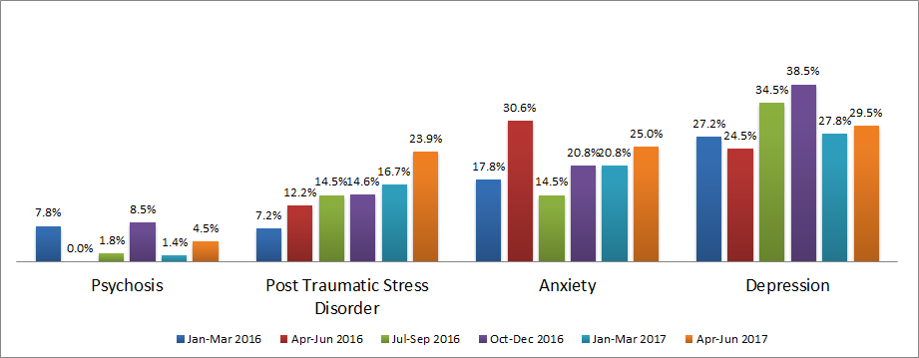
The increase in proportion of mental health symptoms in Lesbos (Greece)
Notes:
http://www.msf.org/sites/msf.org/files/msf_lesbos_vulnerability_report1.pdf

Slide 8
How Blockchain can help
Refugees are biometrically identified
Refugees go to services providers to avail support services
Blockchain immediately disburses payments
Refugees receives payment and buys basic needs
Digital Identification
Smart Contract
Decentralized and Distributed Ledger

Slide 9

We urgently need this blockchain model
Who: International NGOs, international finance institutions and governments
Where: Urban areas in Greece and the EU where 2G, 3G connectivity is high and 90% of refugees have smart phones
What: Smart blockchain for the refugee crisis
When: Now

Slide 10
Technical Overview
Family Contracts Utilizing DAO (Decentralized Autonomous Organization) Framework
Funds held in Transparent Escrow until Goals Are Reached by Participants
Know-Your-Customer Consensus held to mitigate redundancy
Future Goals
Privacy! Use Zero-Knowledge Proofs or Ring Signatures
Proxy Re-Encryption (NuCypher) to serve files privately

